Slide 1

Introduction to Python for Data Science
Session 3 - Machine Learning Algorithms
By Benjamin Frost for City Data Science Society 2019

Slide 2
Introduction
Structure of today
Structure of the course
Week 1: Coding in Python
Week 2: Working with Data
Week 3: Machine Learning Algorithms
Week 4: Advanced Libraries & Class Project
Notes:
I’ve spent the last year completing qualifications and working with academics at City on research projects.

Slide 3
Last week’s classwork

Slide 4
What is Machine Learning?
Machine learning is a subset of artificial intelligence.
It is a way of implementing AI.
Based on the principle that the machine will learn through past experiences.

Slide 5
Supervised vs Unsupervised Machine Learning
Datasets fall into one of two categories: Labelled or unlabelled
Labelled data:
The dataset contains X values and also Y values. The variables that determine the result and the results themselves.
Unlabelled data:
The dataset contains just the X values and no Y values.
X | Y
2 | 7
5 | 8
6 | 5
X
2
5
6

Slide 6
Labelled data → Supervised algorithms
Unlabelled data → Unsupervised algorithms

Slide 7
Machine Learning Algorithms
Regression
Supervised.
Plotting a line of best fit through data. This can be a linear line or polynomial.
Classification
Supervised.
Calculating the category that data may fall into given its properties.
Clustering
Unsupervised
Finding groups of rows given their similarities of properties to other rows.

Slide 8
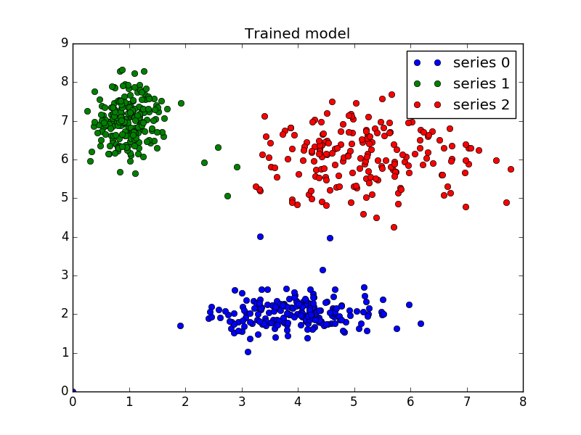
Clustering

Slide 9
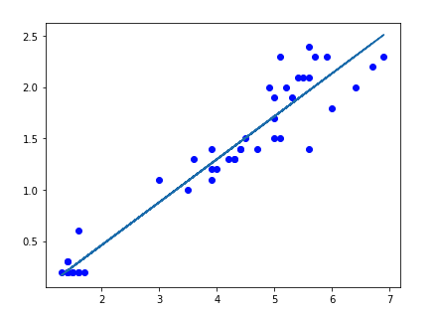
Linear Regression

Slide 10
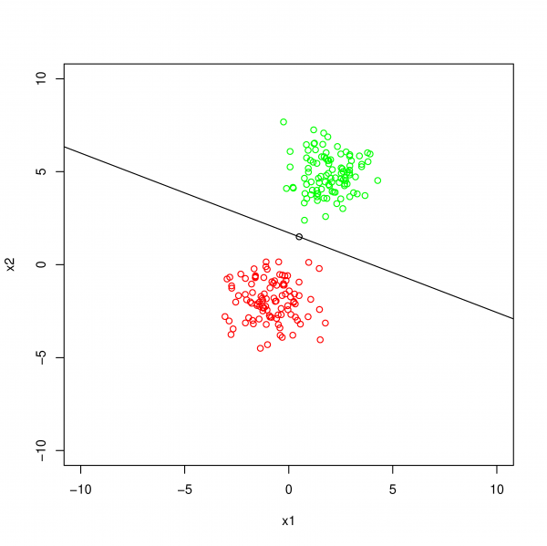
Classification

Slide 11
Today’s Topic: Linear Regression
Society members example.

Slide 12
What is a model?
A model is a way of saving an algorithm.
Y = mx + c → LinearRegression()
LinearRegression().fit(X, Y) → Y = 3.23x + 4.211
LinearRegression().predict(X) → 3.23(X) + 4.211 = Y
1 row of data maps on to one predicted Y value.

Slide 13
Today we are just going to look at one type of linear regression - univariate linear regression.
One variable in X determines Y Y = mx + c
It may be of interest to look into how multivariate linear regression works.
More than one variable in X determines Y Y = m1x1 + m2x2 + m3x3 +c
X | Y
32 | 43
23 | 12
12 | 56
X1 | X2 | X3 | Y
43 | 23 | 32 | 43
56 | 54 | 23 | 12
98 | 56 | 12 | 56

Slide 14
Applications of Regression Algorithms
Predictive analysis - Given the past trends in our business what can we expect in the next few years?
Informing business decisions - Analysing data to back up an expansion plan.
Market research - Is our prediction the same as what the data suggests?

Slide 15
Download the project file from:
https://datasciencesociety.city
Upload it to:
https://jupyter.org/try

Slide 16
Next Week:
Class project

